Slide 1


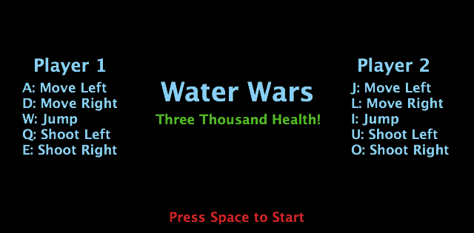
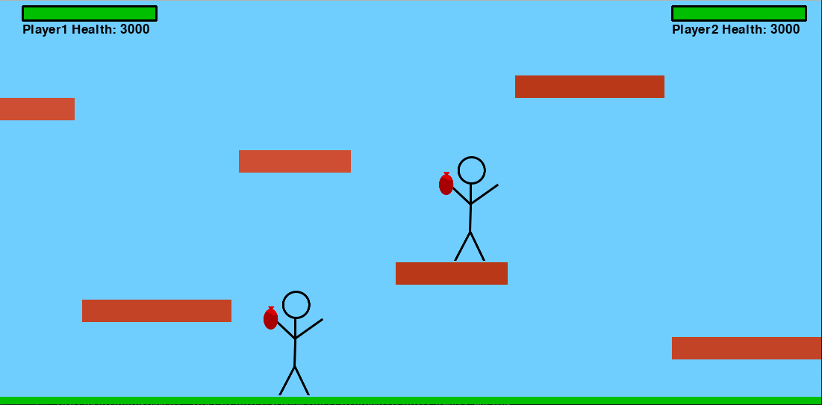
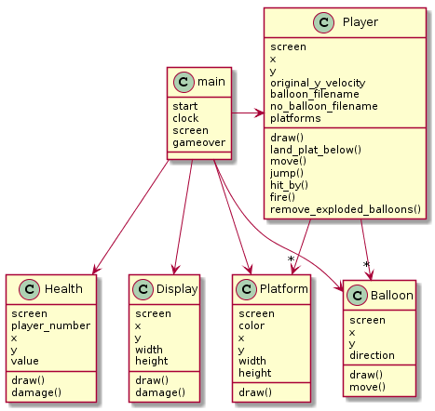
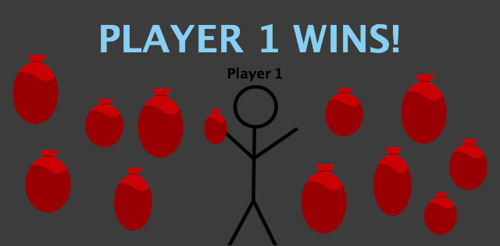
Water Wars
Team 19
Claire Umpleby, Grace Keeton
Operation Catapult 2019 Session 3
Layout:
Problems Encountered:
Allowing the players to land on platforms below them
Organizing a large number of functions
Future Improvements:
Multiple backgrounds
Music for backgrounds
Randomized platform positions
Character customization
Combos
Customizable game parameters
Game Play:
Two players throw water balloons at each other in this street fighter rendition of Water Wars.
Player 1 uses W/A/D to move and Q/E to shoot.
Player 2 uses I/J/L to move and U/O to shoot.
Players start with 3,000 health.
Each balloon hit subtracts from a players’ health until it reaches 0 and the player loses the game.

